Slide 1
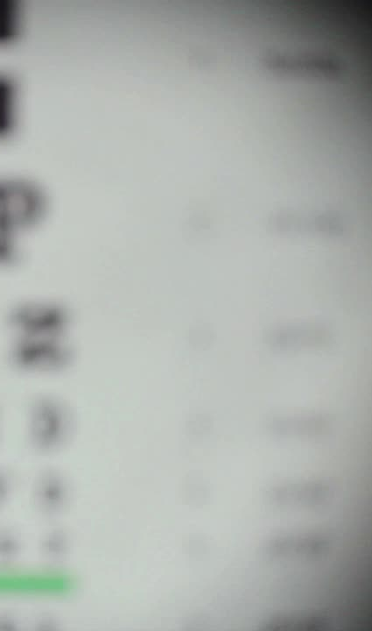
Detection of a Drive Drowsiness based on Eyes closure and Yawning using Aspect Ratio
Shaik Amer Sohail 00848852
DSCI-6612-02

Slide 2
Introduction
Objective: Detect driver drowsiness without adding sensors to minimize cost and system size.
Methodology:
Utilize visual behaviors through a webcam for drowsiness detection.
Employ HAAR cascade for face detection and landmark detection for facial features.
Visual Behaviors:
Implement eye aspect ratio, mouth open aspect ratio, and nose length aspect ratio formulas.
Set threshold values for each aspect ratio to determine normal and drowsy states.
Drowsiness Criteria:
Yawning detection: Aspect ratio greater than 0.6.
Head bending: Aspect ratio less than 0.7 or greater than 1.2.
Eye aspect ratio exceeding the threshold.
Alert System:
Generate drowsy alerts if yawning and head bending criteria are met.
Activate alert if only eye aspect ratio indicates drowsiness.

Slide 3
Existing System
Proposed System
Vehicle-based and physiological-based techniques used for detecting driver drowsiness.
Utilized ECG and heartbeat sensors to measure fatigue levels.
Increased system cost and size due to the use of sensors.
Avoids the need for sensors attached to the driver.
Visual behavior-based system for driver drowsiness detection.
Utilizes eye aspect ratio, mouth opening ratio, and nose length ratio.
Defines threshold values for each ratio to determine normal and drowsy states.
Applies the HAAR cascade algorithm for accurate face detection.

Slide 4
Technology used and software's
Operating system: Windows
Technology: Python 3.6
IDE: Pycharm
Data Base: MySQL5.5

Slide 5
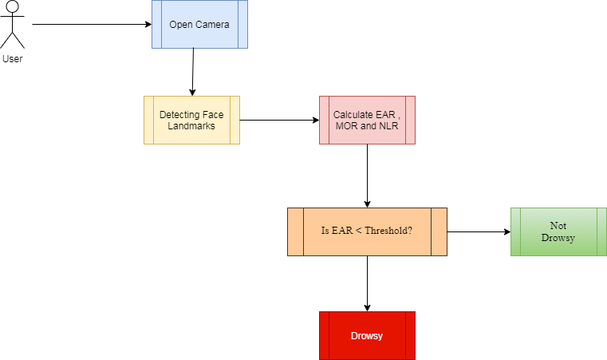
Block Diagram

Slide 6
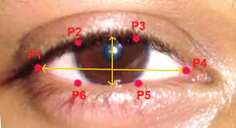

Eye Aspect Ratio
The Eye Aspect Ratio (EAR) is a measure used in computer vision and facial recognition to quantify the opening or closure of the eyes. It is particularly useful in applications like driver drowsiness detection systems, where monitoring the driver's eyes can help determine their level of alertness.
The Eye Aspect Ratio is typically calculated using the following formula:
EAR=$\frac{\left|p2−p6\right|+|p3−p5|}{2∗|p1−p4|}$​
Where:
p1,p2,...,p6 are six specific facial landmarks.

Slide 7
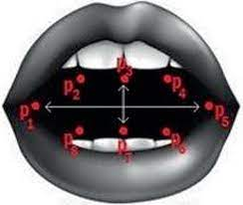

Mouth Aspect Ratio
The Mouth Aspect Ratio (MAR) is another facial feature used in computer vision and facial expression analysis. Similar to the Eye Aspect Ratio (EAR), the Mouth Aspect Ratio is used to quantify the shape and movement of the mouth. It is particularly useful in applications like facial expression recognition and driver drowsiness detection systems.
The Mouth Aspect Ratio is typically calculated using the following formula:
MAR = $\frac{ \left|p9−p3\right|+\left|p10−p2\right|+\left|p8−p4\right|+|p7−p5|}{4∗|p1−p6|}$
P1,p2……p10 are ten specific facial landmarks

Slide 8
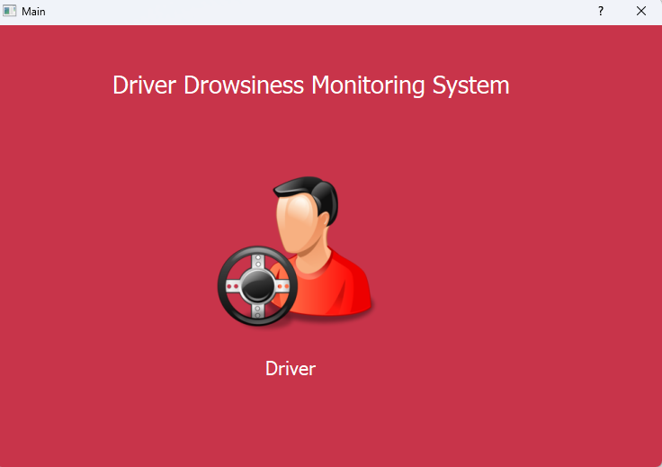
Results and Output
When you run the `Main.py` file, a frame will popup with driver image, which is designed using pyQt5 as shown in fig.

Slide 9
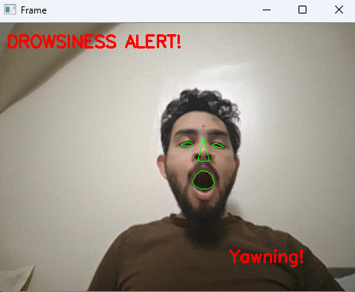
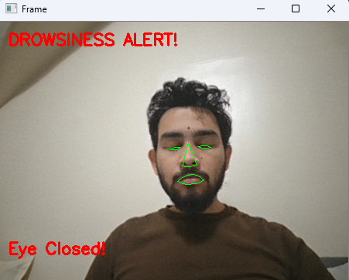
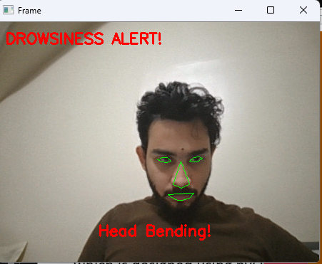

Slide 10
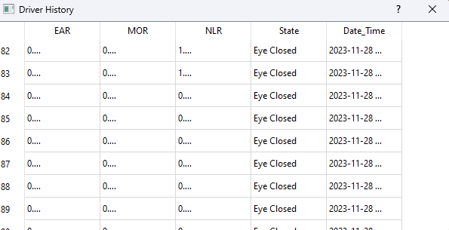
Data set

Slide 11
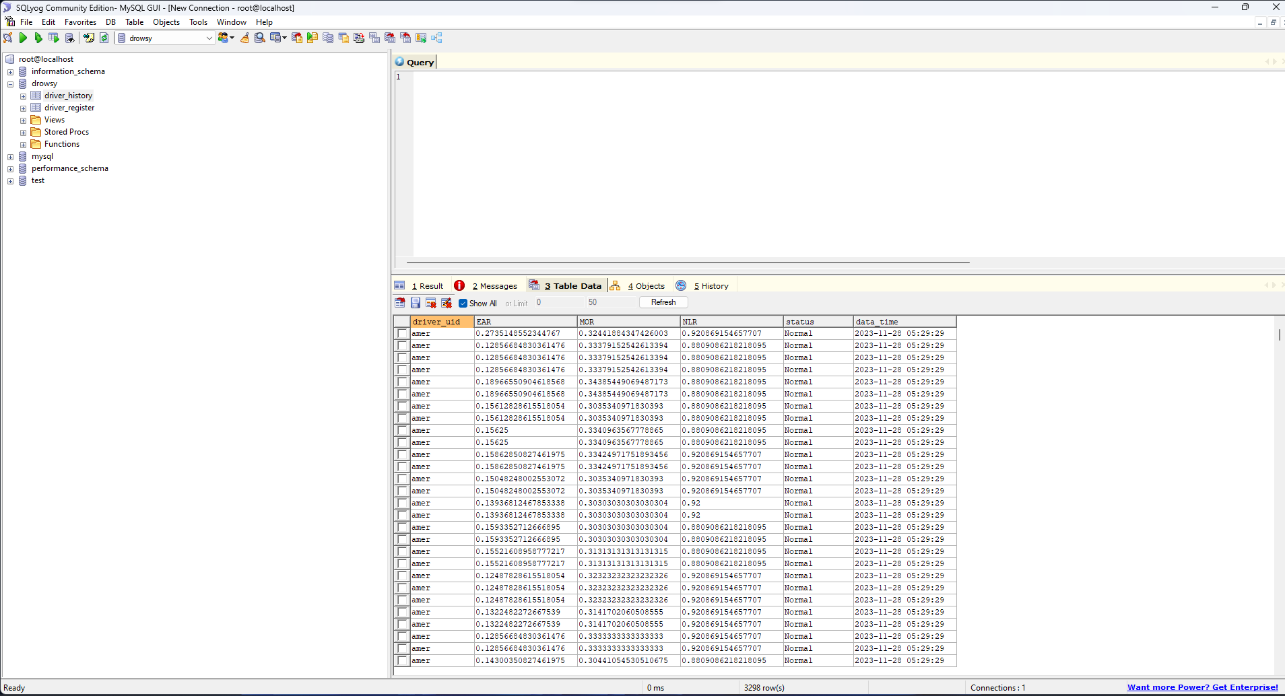
SQL Data set

Slide 12
Conclusion
The system achieves accurate driver drowsiness detection by leveraging three aspect ratios derived from visual behaviors. Additionally, an SVM (Support Vector Machine) classifier has been implemented to predict drowsy status, distinguishing between normal, yawning, head bending, and eye closing. The SVM classifier demonstrates a high accuracy of 95%, surpassing the performance of the naïve Bayes classifier. In comparison to previous methods such as physiological or vehicle-based approaches, the current system significantly improves the detection of drowsiness in drivers.

Slide 13
Thankyou

